Slide 1
Software Engineering (ICT 3159)

Slide 2

Faculty details
Sucheta Kolekar
9008773043
Sucheta.kolekar@manipal.edu
Whats APP/MS Teams/Mail/Calls/ Cabin number 12

Slide 3
Subject Overview
Software Engineering: 4 hrs. per week (3 Theory classes+1Tutorial)

Slide 4
Syllabus Theory
Introduction to Software Engineering
Software Engineering Process Models:
Modeling using Unified Modeling Language(UML)
Design Engineering
Architectural and Design Patterns
Software Testing Strategies and Testing Techniques
Software Configuration Management and Risk Management
Project Management: Scheduling and Estimation

Slide 5
Course Objectives: Theory
To learn the Concepts of Software Engineering
To understand the Software Development Life Cycle
To learn the basic principles behind software configuration and risk management
Model software requirements for application development
To learn architectural, design patterns for design of complex, scalable software systems

Slide 6
Course Outcomes
Understand the basics of software development life cycle
Understand the basic principles behind software configuration and risk management
Explore the importance of requirement analysis through scenario-based exercise
Adapt software design strategies using object-oriented concepts
Identify a suitable testing strategy to validate a given software application

Slide 7
Study Materials
1. Roger S. Pressman “Software Engineering A practitioner's approach”- McGraw Hill, 7th/8th edition, 2015
2. Ian Somerville, “Software engineering”, Addison Wesley, 10th Edition, 2017.
3. Grady Booch, James Rumbaugh, Ivar Jacobson, “The Unified Modeling Language User Guide”, Pearson Education, 2nd Edition, 2015.
Slides
Recordings
Your own notes

Slide 8
Theory: Mode of evaluation
Internal Marks: 50
3 Quizzes in 3rd, 5th and 7th week : 10 Marks
2 Assignments in 4th and 6th week : 10 Marks
2 Sessional Tests: 30 Marks (schedule will be received by September)
External Marks: 50
No guidelines are provided yet

Slide 9
Mandatory Requirements
Stationary: Pencil, Pen, Scale, Eraser, Sharpener, A4 Sheets (Many), Separate Notebook
Two CR for controlling the meeting
6/7 volunteers for interaction during class in the meeting

Slide 10
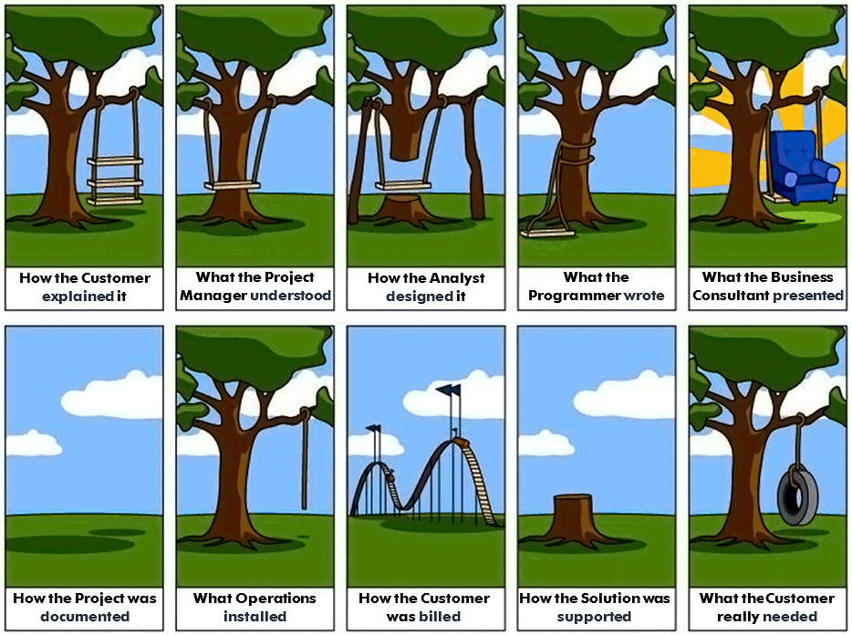

Slide 11
$250 billion annually in US and approximately equal in India
Over 175,000 projects!
Complexity, size, distribution, importance push our limits.
Business pushes these limits:
Great demands for rapid development and deployment
Incredible pressure: develop systems that are:
On time,
Within budget,
Meets the users’ requirements
Figures in the late 90s indicated that at most
70% of projects completed
Over 50% ran over twice the intended budget
$81 billion dollars spent in cancelled projects!!
Getting better, but we need systematic way and better tools and techniques!

Slide 12
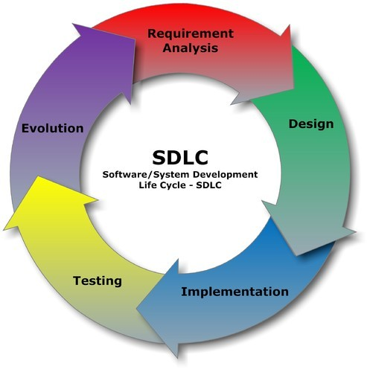
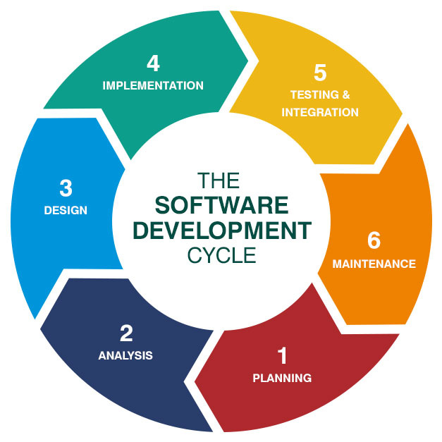
Software Development Life Cycle (SDLC)

Slide 13

Software Engineer’s Life Cycle (SELC)

Slide 14
Basic Terminologies
Software
Engineering
Software Engineering
Requirements
Design and modelling
Testing
Quality
Coding
Deployment
Maintenance
Updates
Change/Version control
Risk

Slide 15
Need of Software Engineering
Large software
Scalability
Cost
Dynamic Nature
Quality Management

Slide 16
Activity
Job Profiles based on Software Engineering and UML: Everyone should list atleast 10 job profiles.

